Slide 1
Capstone Project 2: House Price Prediction
Piyush Aggarwal

Slide 2
Contents:
Problem Statement
Description of Dataset
Data Wrangling
Exploratory Data Analysis(EDA)
Modeling
Result Analysis
Recommendation for clients
Future Work

Slide 3
Problem Statement :
To predict the final price of each home according to the market prices, taking into account different features ranging from the basic amenities to that of its proximity to public transport hub.
Buyers Sellers
Agents

Slide 4
Scope of solution space:
1. Find the Actual Price of the house
2. Save the money from Middle Man
Constraints within the solution space: Predictions are not always correct.
Stakeholders:
1. House owners
2. Buyers
3. Investors
4. Agents

Slide 5
Description of Dataset:
Dataset is from Ames, Iowa Housing dataset from Kaggle.com
https://www.kaggle.com/c/house-prices-advanced-regression-techniques/data
Explanatory variables (features): 81
Observations: 1460
Target variable: SalePrice
Datatypes: int, float, object, with some null values

Slide 6
Data Wrangling:
Feature columns with null values > 80% removed
Filling null values:
int/float features - average (mean) of the column
object/categorical features – frequently occurred category
Shape of dataset:
1460 observations
81 columns => 5 columns removed

Slide 7
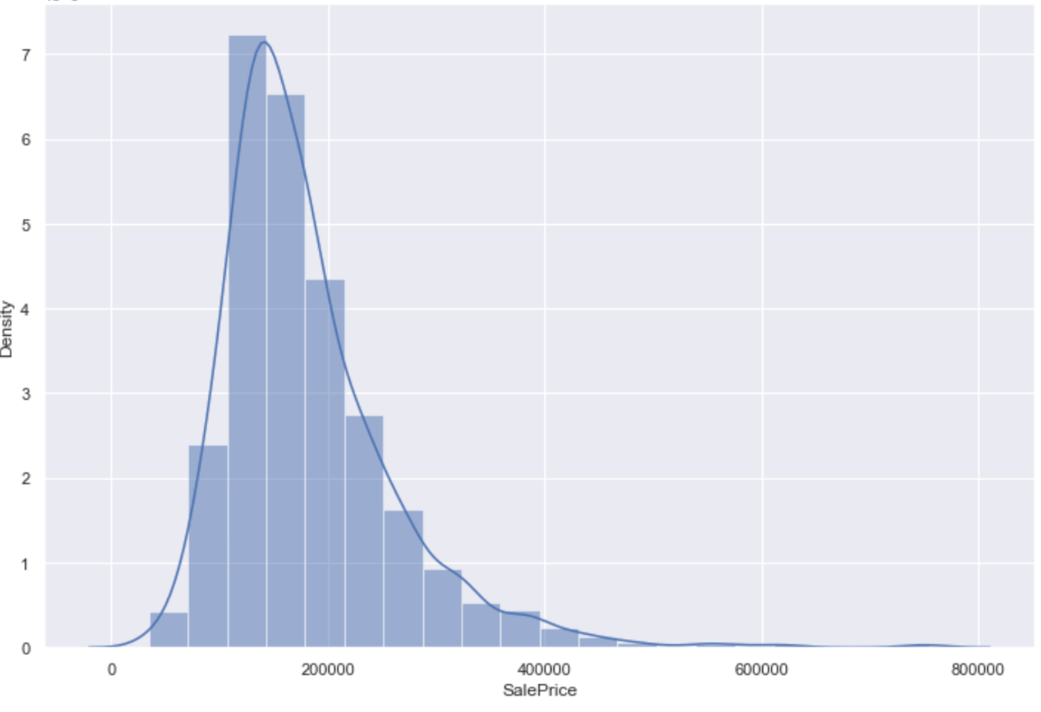
Exploratory Data Analysis: Histogram:

Slide 8
Boxplot:

Slide 9
Heatmap:

Slide 10
Scatter plot:

Slide 11
Feature Engineering:
Filter features which have a positive or negative impact on the target variable.
Features impacting on target with same amount then we select one among them hence it reduces the feature size to 76.
Categorical features into dummy features which leads to 320 columns.
Data Normalization - transforming numeric columns to a common scale.
Splitting dataset into training and test dataset.

Slide 12
Modeling:
Column1 | Column2 | Column3 | Column4 | Column5 | Column6
Sno | Model | RMSE | R^2 | Parameters | Reviews
1 | Linear regression | 0.099633 | 0.362271 | NA | Very Bad Performance
2 | Ridge Regression | 0.0142918 | 0.9085220 | Alpha =100 | Very Good Performance
3 | Lasso GridSearchCV | 0.013089 | 0.916220 | Alpha =0.01 | Good Performance

Slide 13
Conclusion and Future Scope:
Analyse the dataset.
Filter the dataset and find correlated features
Feed these futures to three algorithms:
Linear Regression, Ridge Regression, Lasso GridSearchCV
Ridge Regression model selected as final model based on its performance to train the data.
Future Scope:
Work on larger data set
Make use of more algorithms

